Slide 1

Stroke Prediction Models
Andrew Makowski
Guang Yang

Slide 2
Project Description
For this project we wanted to build a machine leaning algorithm to cycle thought patient’s medical data to predict if the patient might have a stroke in the future.
The data we collected from consist of patient's machine information such as:
Gender
Age
Hart Disease
Glucose level
BMI
Smoking status
Past strokes
Patient’s Info

Slide 3

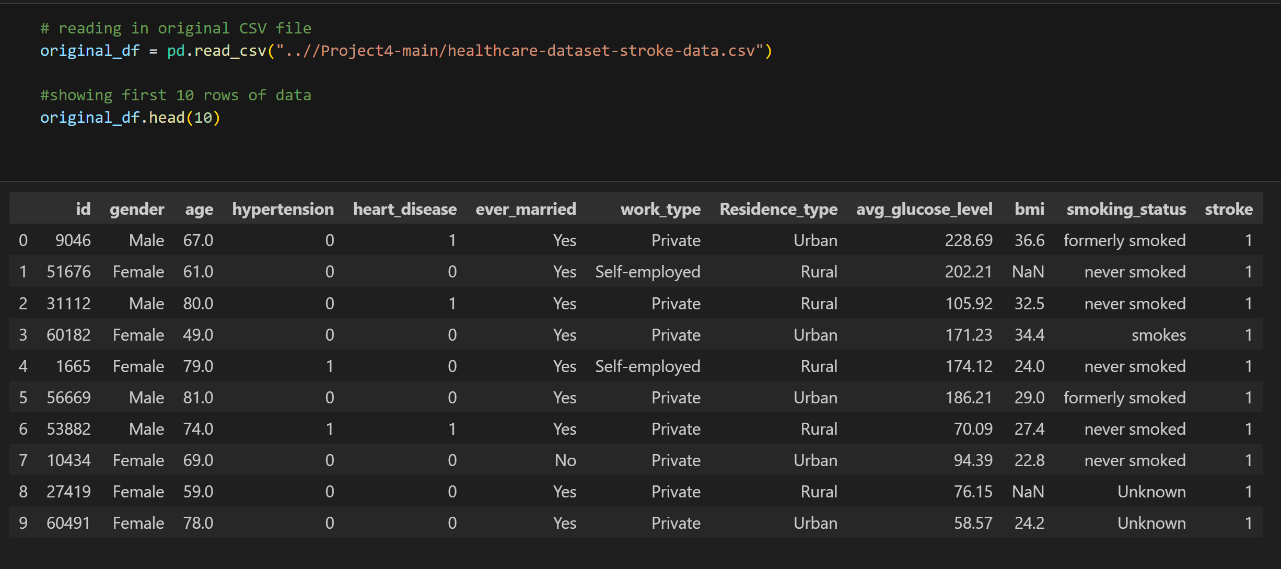
The Dataset
The dataset we used was “Stroke Prediction Dataset” from Kaggle
https://www.kaggle.com/datasets/fedesoriano/stroke-prediction-dataset

Slide 4
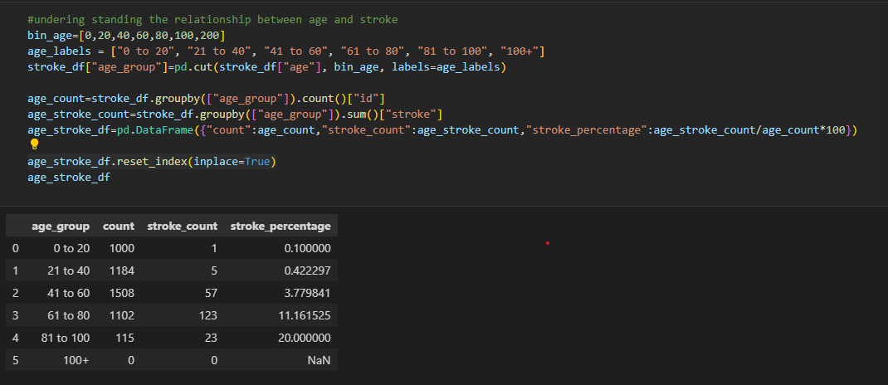
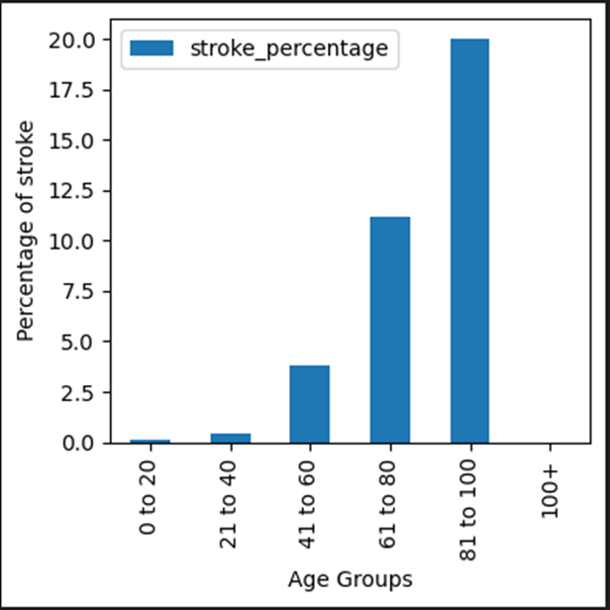
Analyzing The Factor
Next, we calculated the parentage of how many of our patient’s have already had a stroke some time in their life and compared that parentage to each factor in our dataset.

Slide 5
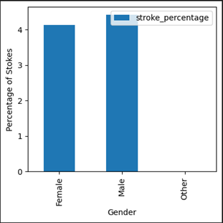

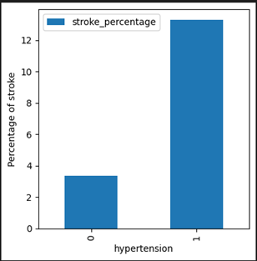
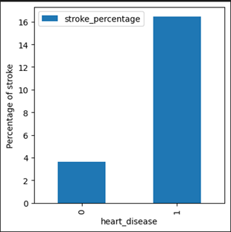
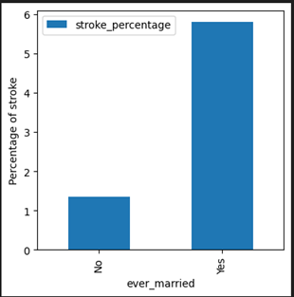
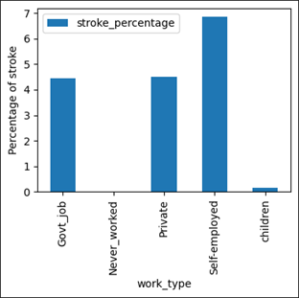
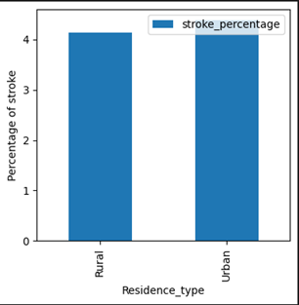
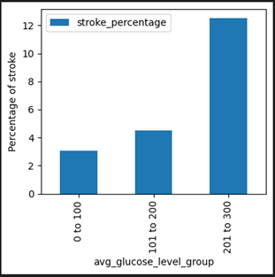
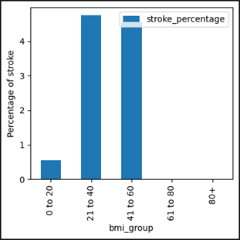
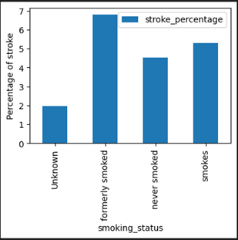
Factors impacting stroke or not

Slide 6
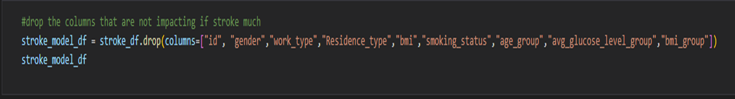
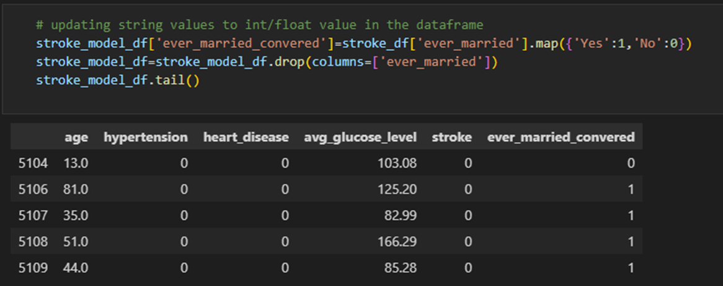
Clean Data frame to start machine learning model

Slide 7
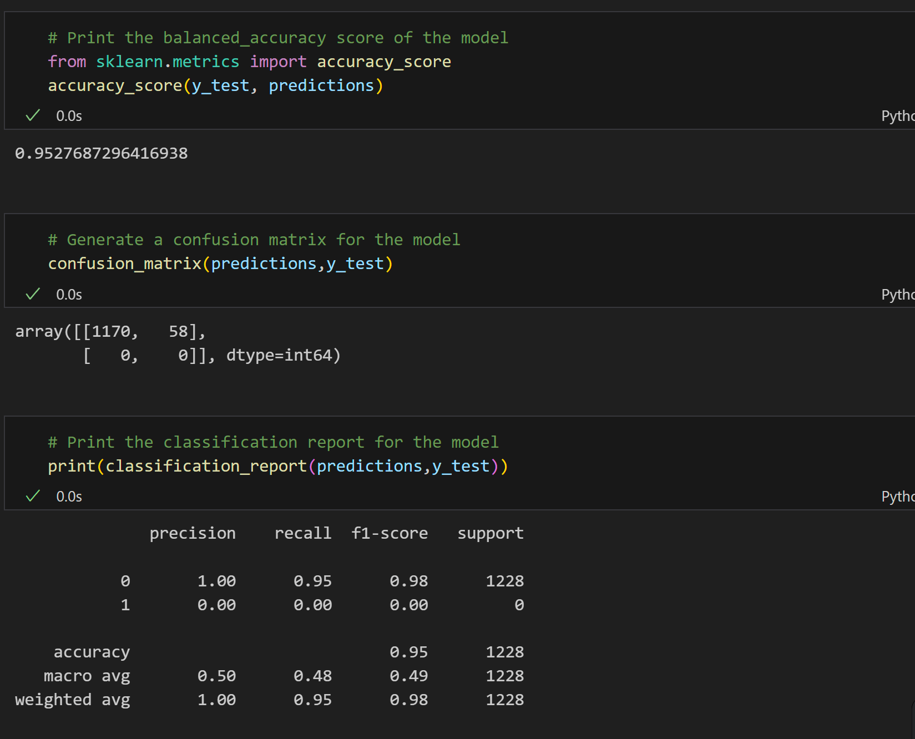
Logistics Regression Model

Slide 8
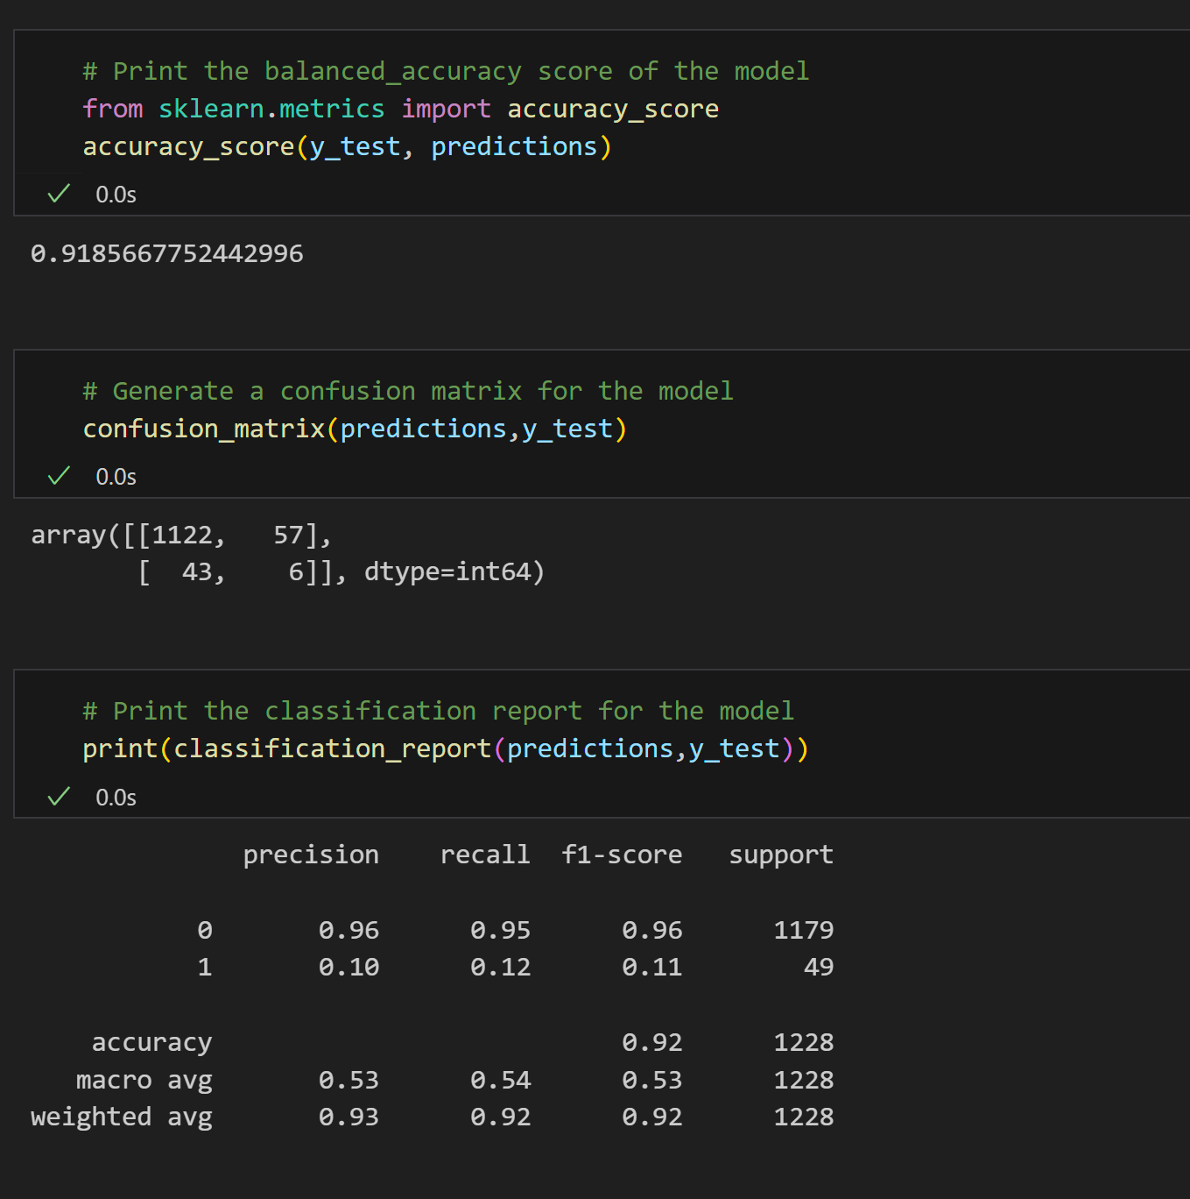
Decision Tree Model

Slide 9
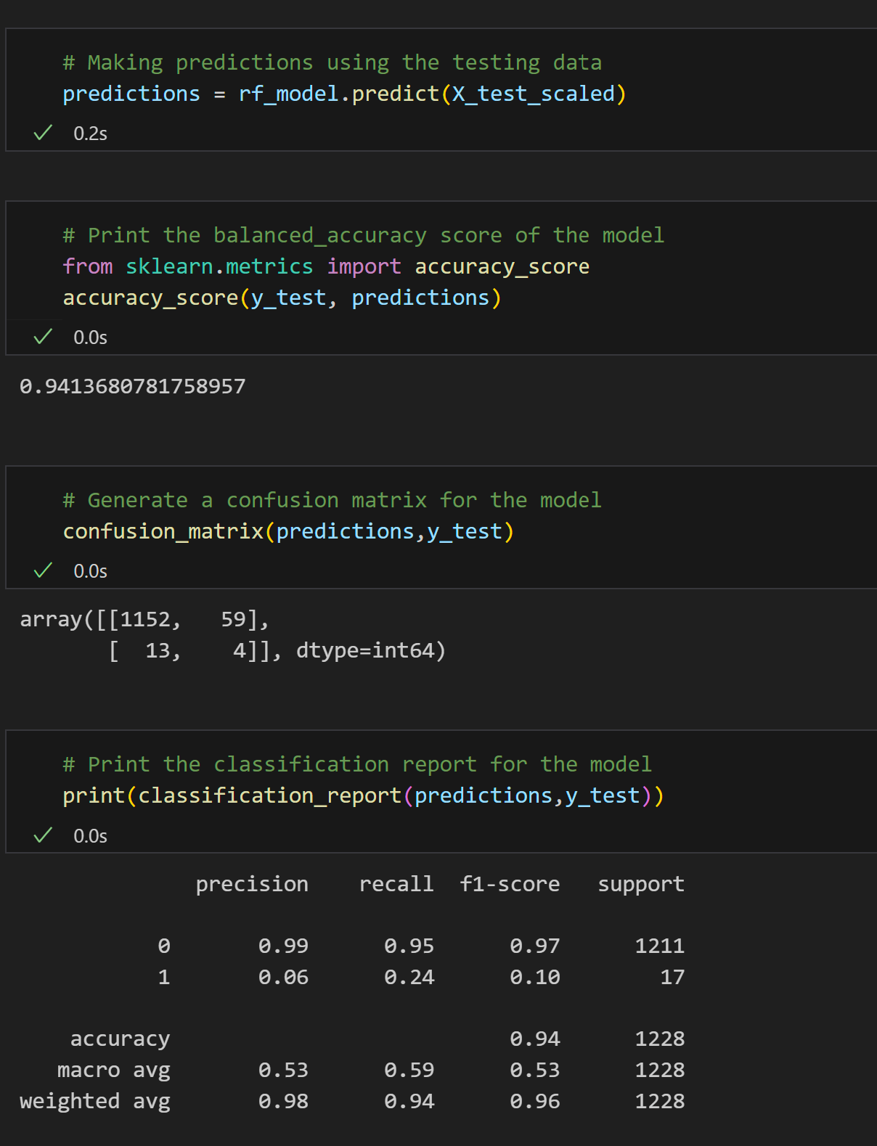
Random Forest Model

